Slide 1
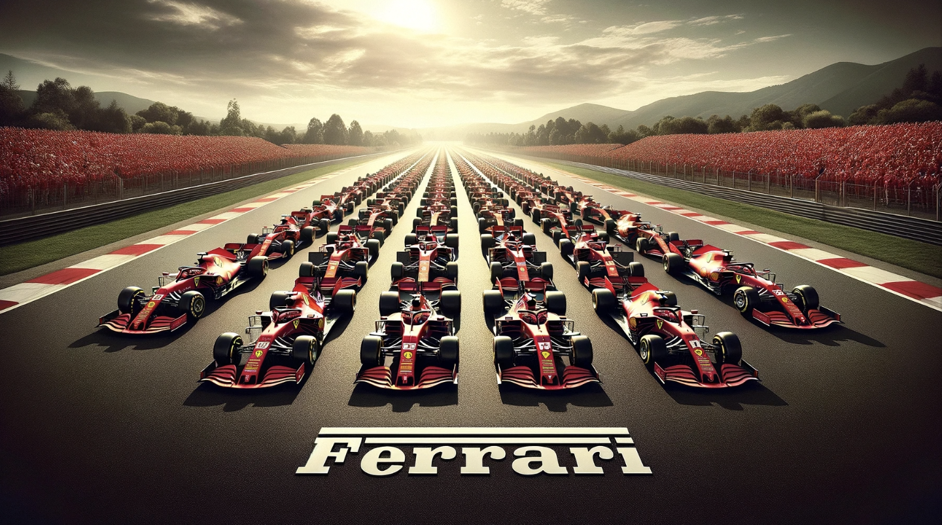

Slide 2
1.
Historical Significance
Ferrari is the oldest and most successful team in Formula 1 history.
Dominance forces in this sport since 1950.
2.
Championship Titles
15 Driver Titles
16 Constructor Titles
813 podiums
3.
Legendary Drivers
Michael Schumacher
Niki Lauda
Clay Regazzoni
Alberto Ascari
Juan Manuel Fangio…

Slide 3
Ferrari Constructors Championships

Slide 4
Ferrari Drivers Championships

Slide 5
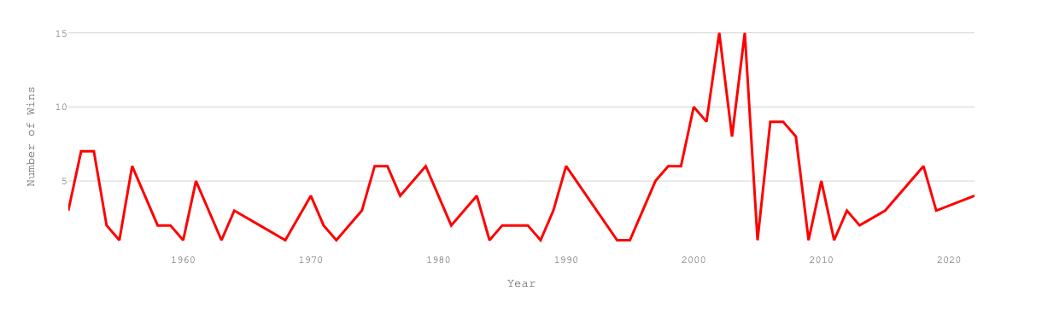
Number or F1 Races won by Ferrari
The highest wins are in 2002 and 2004 with 15/17 wins and 15/18 Races respectively .

Slide 6
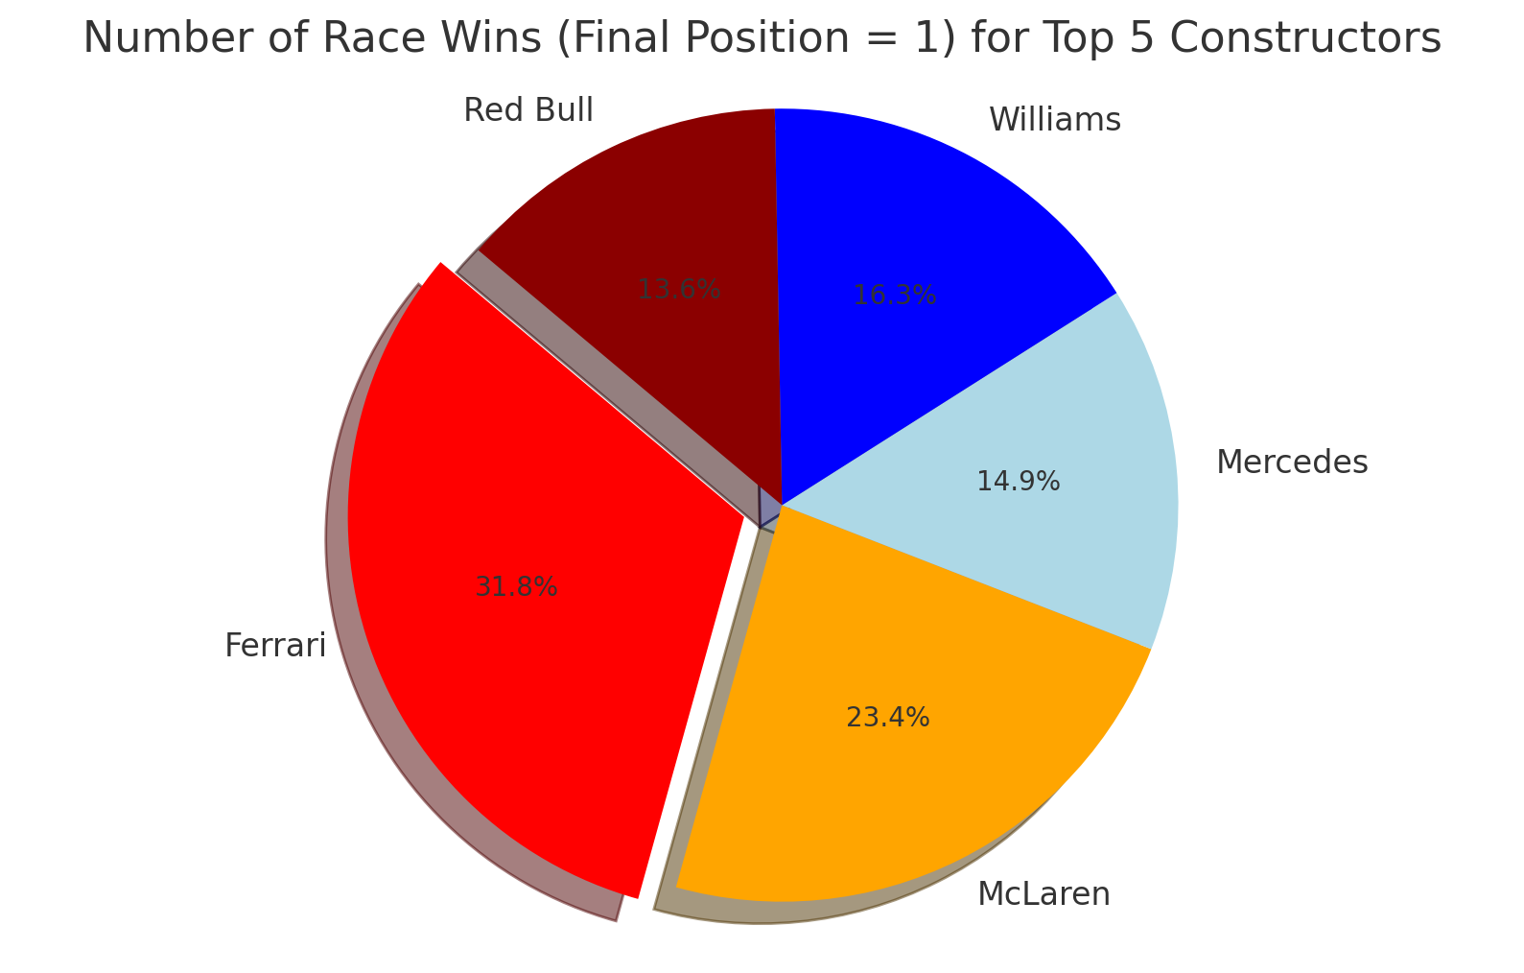
Number of Race Wins
Top 5 Constructors

Slide 7
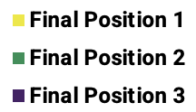
Top 10 Teams by Total Podium Finishes
Teams
Podiums

Slide 8
Wins by Race Track
Race Track

Slide 9
Fastest Lap Time per Circuit for Ferrari Team

Slide 10
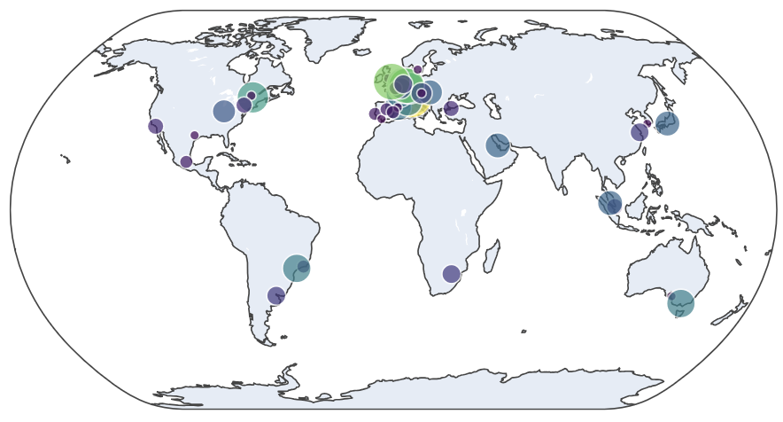
Map of Ferrari´s Most Won Races Worldwide

Slide 11
Longest serving drivers in Ferrari's racing history
10
8
6
Number of Years
4
2
0
Driver
Michael Schumacher
Kimi Räikkönen
Felipe Massa
Clay Regazzoni
Sebastian Vettel

Slide 12
Top 10 Podium Finishers by Ferrari Drivers

Slide 13
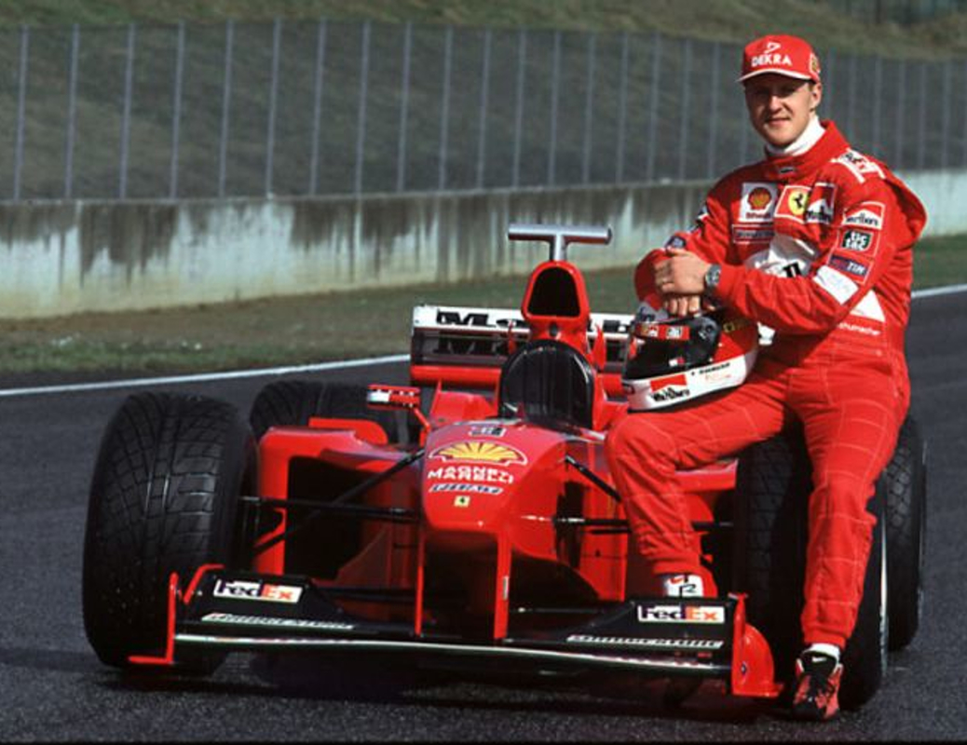
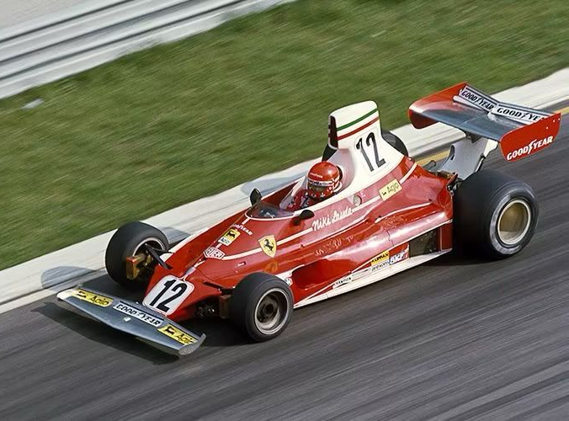
Iconic Cars
Michael Schumacher
Niki Lauda

Slide 14
